Slide 1
Team Foundation Server
Lothar Wieske
Lifecycle Management Technology Specialist
Microsoft Deutschland GmbH

Slide 2





Agenda
Team System
Team Foundation Server
Architecture
Functionality
Work Items
Version Control
Team Build
Project Portal
Reporting
Integration

Slide 3







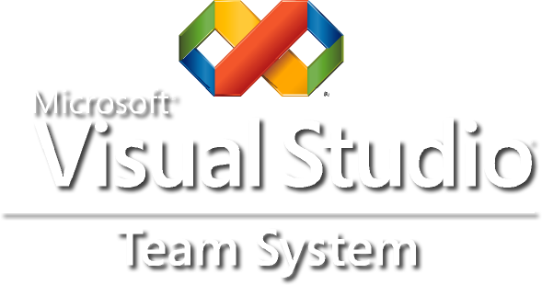
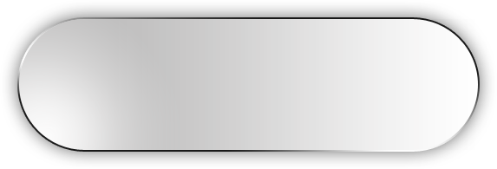
Application Lifecycle Management
Developer
Architect
Tester
Project Manager
Integration
Business Analyst
Process guidance & enforcement drives greater predictability
Office integration drives consistent workflow across roles
Out of box productivity results in lower training costs

Slide 4



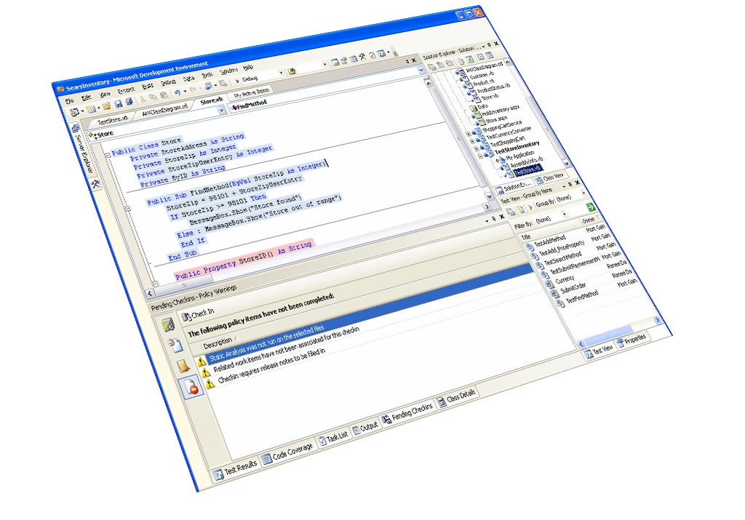
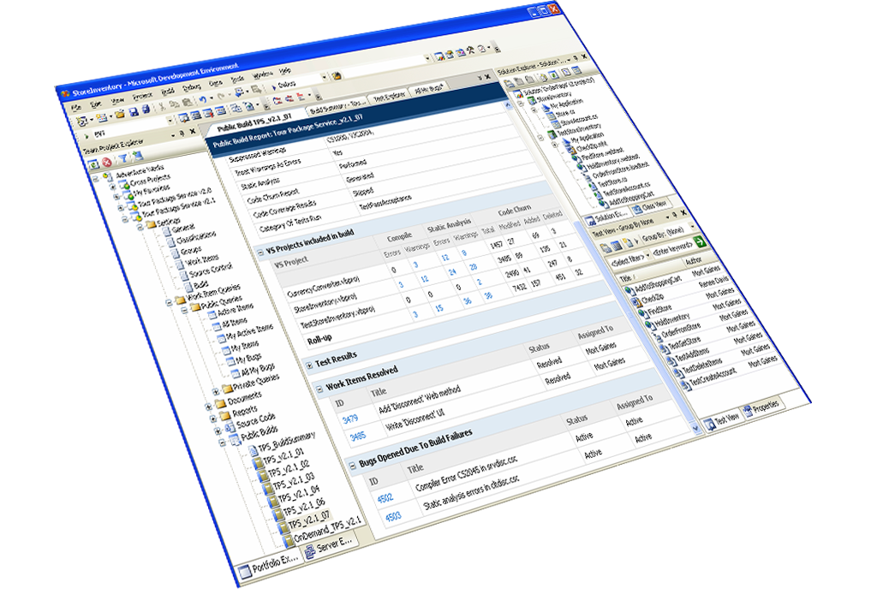
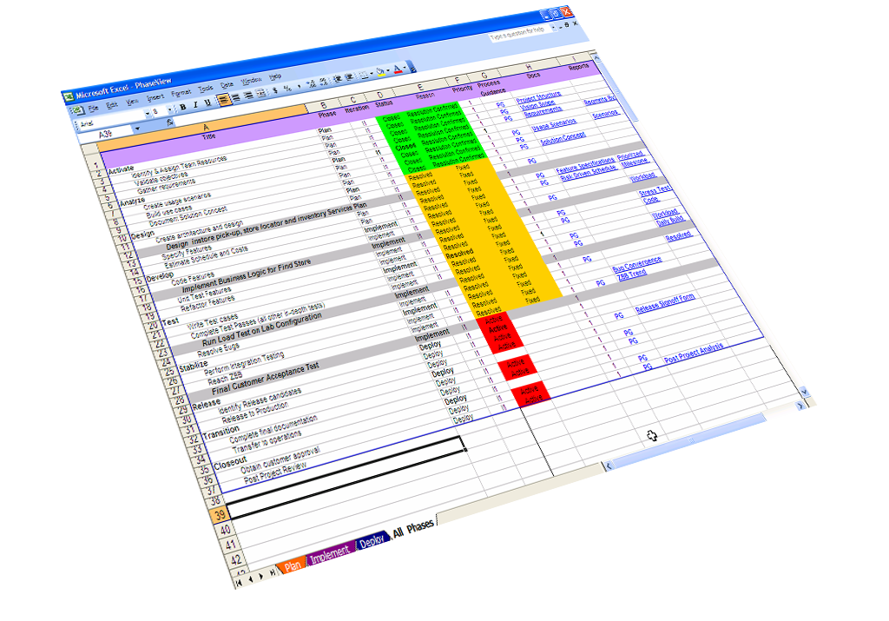
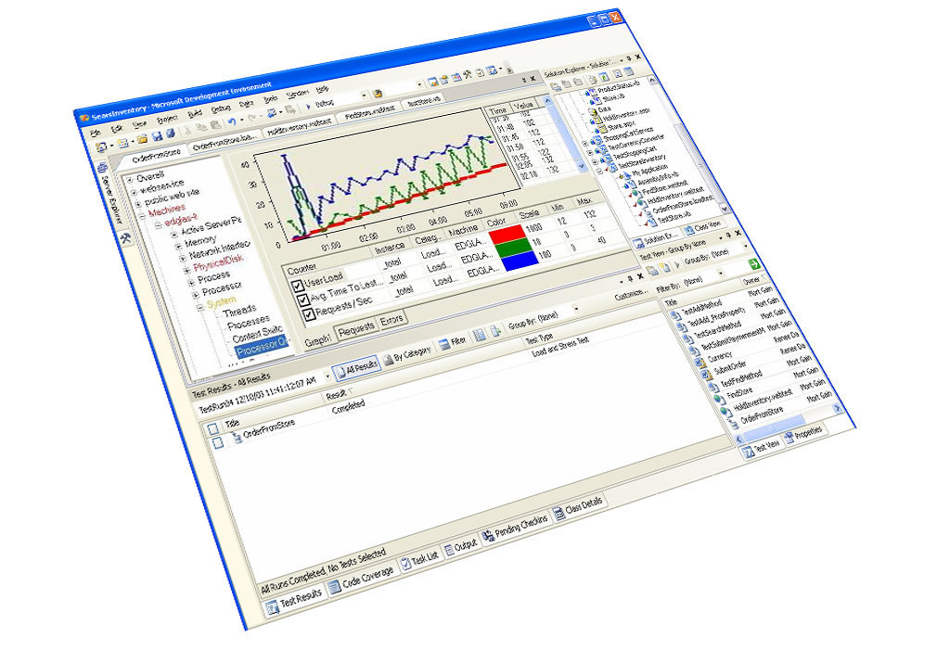
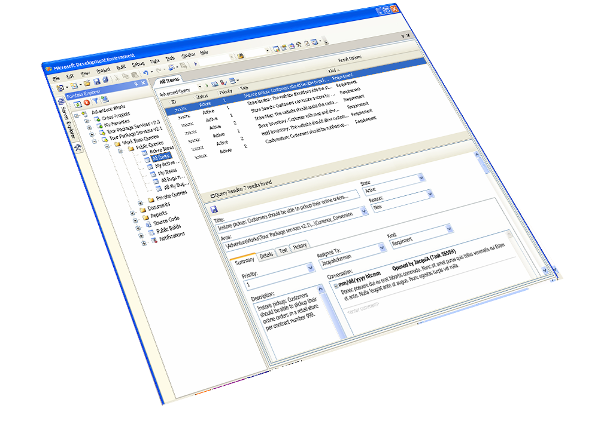
Instrument the Lifecycle
Single data repository offers true insight
Real-time reports for real-time decisions
Process management minimizes variability

Slide 5
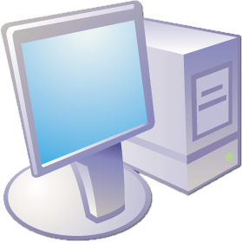
Team System – Three-Tier Architecture
Client Tier
Visual
Studio
Office
Other
Application Tier
TFS Integration
Services
TFS Data
Services
Team Foundation Server
Data Tier
Database
Warehouse

Slide 6
Team Foundation Server – Functional Architecture
Team Foundation Object Model
SOAP / HTTP(S)
ASP.NET
WSS
Team Foundation Integration Services
Notification Service
Linking Service
Registration Service
WebParts
Team Foundation Data Services
SSRS
Work Item Service
Version Control Service
Team Build Service
Reports
MSSQL/TCP
SQL
Team Foundation Data-Tier
Lifecycle
Work Items
Version Control
Team Build
Warehouse

Slide 7
TFS – Building Blocks
Work Items
Version Control
Reporting
Team Build
Project Portal
Team Foundation Object Model
ASP.NET
WSS
Team Foundation Integration Services
Team Foundation Data Services
SSRS
SQL
Team Foundation Data-Tier

Slide 8

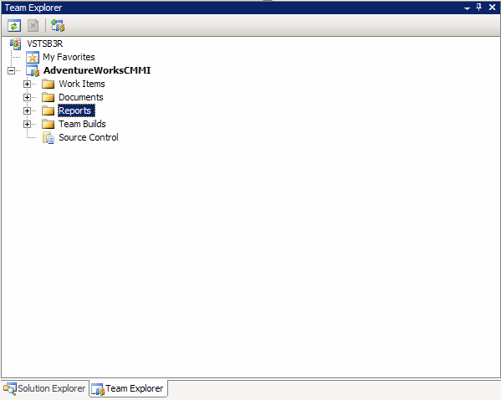
Team Project
Team Explorer
Multiple team projects per Team Foundation Server
A Team Project
… collects work items, code, tests, work products, metrics, in its own namespace
… select tooling
… enhances reporting
Process Templates
… configure team project creation

Slide 9
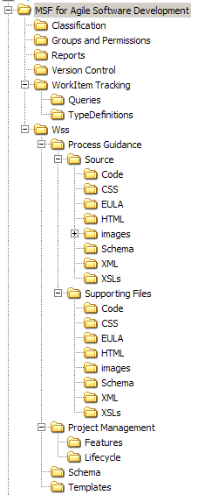
Process Template
Process Templates
… define the methodology
… specify the tools
… give process guidance
Process Definition Files
… select and order plugins
Process Template Plugins
… perform specific setup tasks
E.g. Work Item Tracking – work item types/instances
E.g. Version Control – security, …

Slide 10
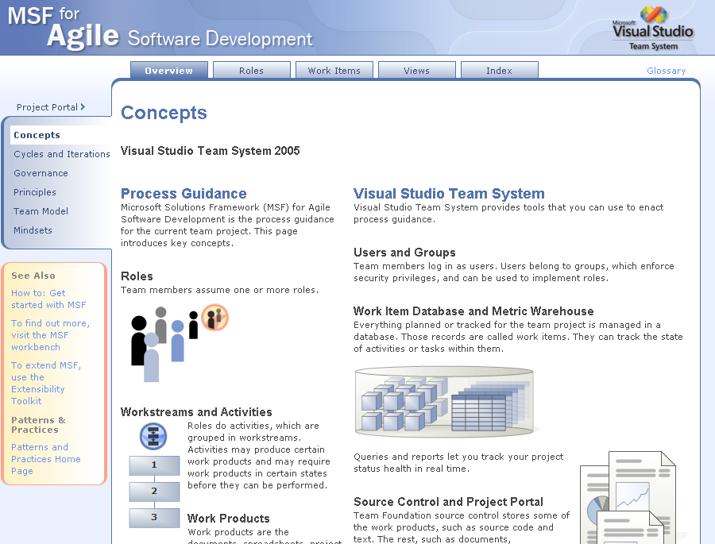
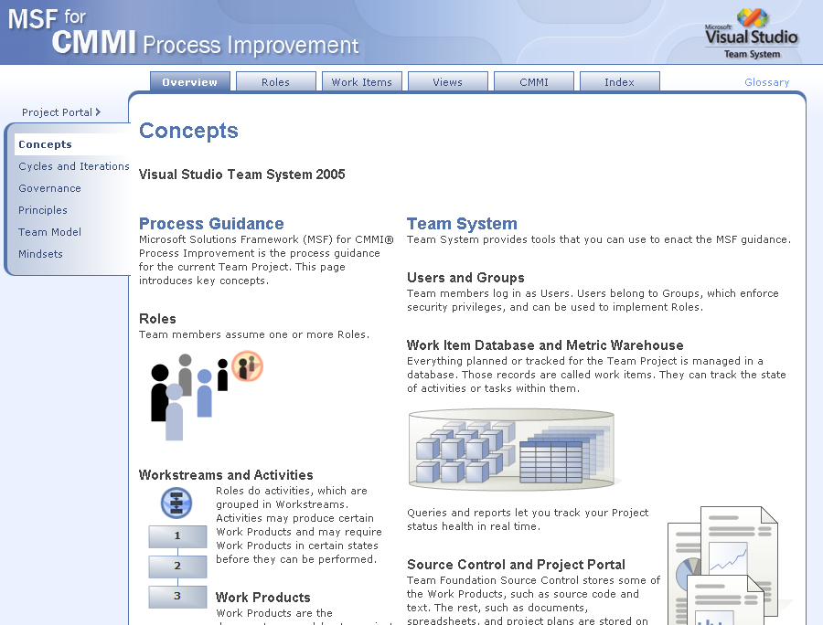
Microsoft Solution Framework
MSF for Agile Software Development
“Evolve and adapt”
… Competitive Environments
Rely on People
Plan as you go
MSF for CMMI Process Improvement
“Plan and optimize”
… Regulated Environments
Rely on Process
Plan in advance

Slide 11
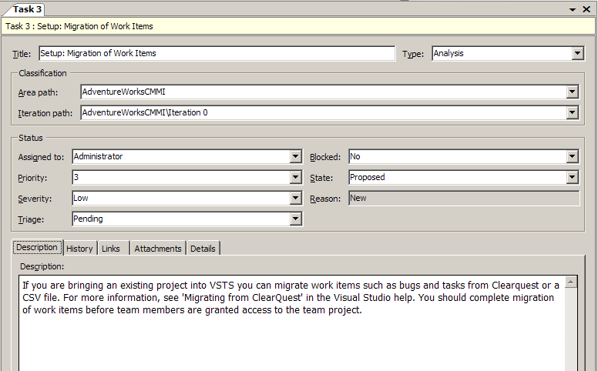
TFS – Work Items
Work items assist teams to manage their work
Common elements:
Fields
Rules
Form
State-transition model
Common characteristics:
Share a set of common system fields.
Track comprehensive history of changes
Support links and attachments to other artifacts
Although two team projects might start with the same work item type definition, over time, they might diverge as project administrators change the definitions to suit the requirements of each team project. A change in one team project's work item type definition does not affect the other.

Slide 12
TFS - Work Items+TFS
*
*
Project
Structure
Iteration
Structure
*
*
Build
*
*
Work
Item
*
*
Test
Result
*
*
*
*
*
Latest
Item
Version
Changeset
Label
Versioned
Item

Slide 13

Demo: Process Templates + Work Items
Lothar Wieske
Lifecycle Management Technology Specialist
Microsoft Deutschland GmbH

Slide 14
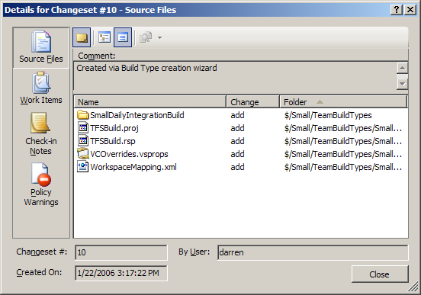
TFS - Version Control
Changesets
Logical container for atomic checkins
Lifecycle elements
Work items
Check-in notes
Policy warnings
Shelvesets
Set aside changes without checkin
Examples
Interrupt
Integration
Review
Backup
Handoff
Policies
Restrict changes that can be submitted
Work items associated
Checkin tests pass
Static analysis is clean
Extensible through plugin model
Build your own!

Slide 15

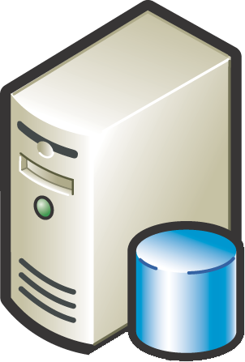
TFS – Version Control Checkin
Workspace
1
Validate
3
4
2
Policy
Update
Mail
Commit
4
12
12
V5
9
12
Work Item
Changeset

Slide 16
TFS - Team Build Concepts
Build Type
Provides an interface which allows the user to define the build steps and build parameters needed for their builds.
Build Execution
Leverages the build type to generate build outputs
Executes build steps including execution of test code with coverage data, updates work items, and calculates metrics.
Build Report
Provides a view into the execution of the build.
The report lists the overall build status including detailed build steps, work items resolved, code changes, and summary of test execution.

Slide 17
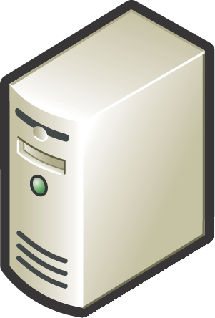
TFS – Team Build Execution
Client Tier
Application Tier
Build Machine
Drop Location
Data Tier
Initializing build
Getting sources
Compiling Sources
Compiling <Solution>
Compiling <Project>
Running tests
Getting changesets
Updating workitems
Copying binaries to drop
Copying logs to drop
Completed

Slide 18
Demo: Version Control / Team Build
Lothar Wieske
Lifecycle Management Technology Specialist
Microsoft Deutschland GmbH

Slide 19
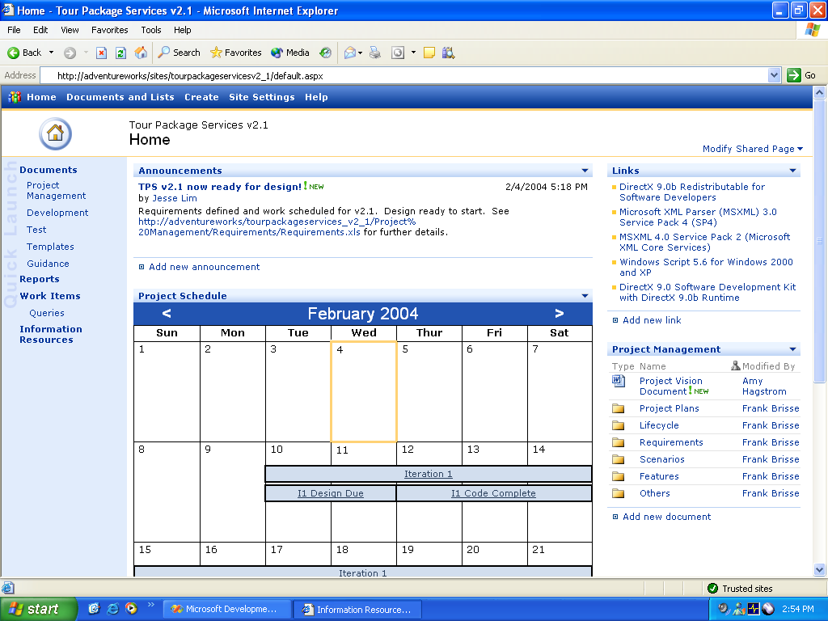
TFS – Project Portal

Slide 20
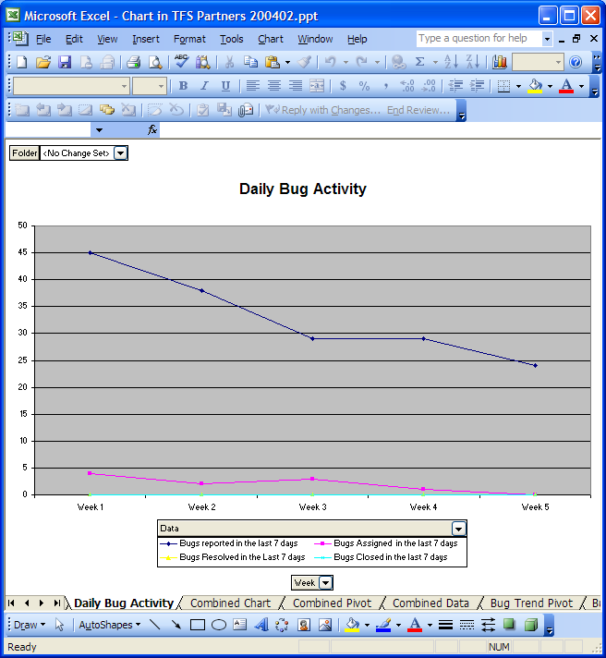

TFS – Reporting Architecture
SQL Server
Reporting
Services
Excel
Custom Reporting
Reporting Warehouse
Team Build PULL Adapter
Reporting Warehouse Object Model
Work Item PULL Adapter
Version Control PULL Adapter
Your PULL Adapter
Work Items
Version Control
Your Tool

Slide 21
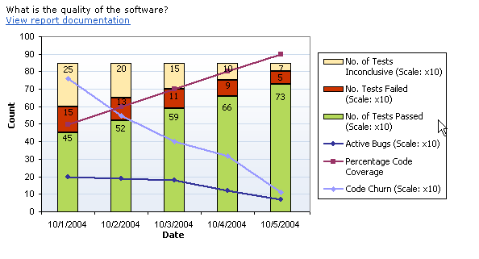
TFS Reporting – Quality Indicators

Slide 22
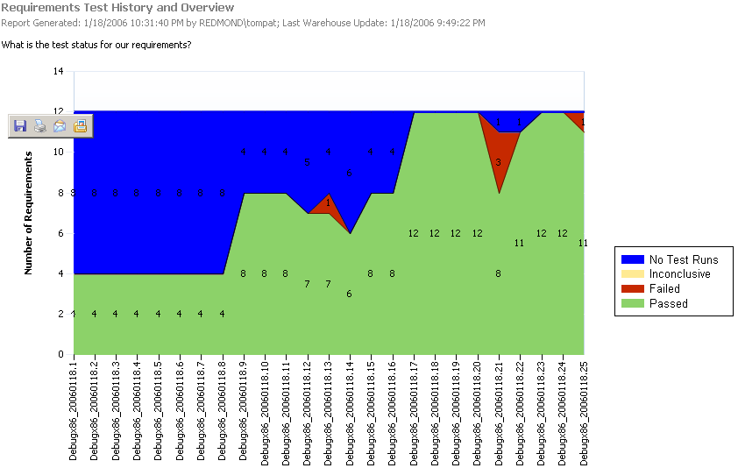
TFS Reporting - Requirements Test History

Slide 23
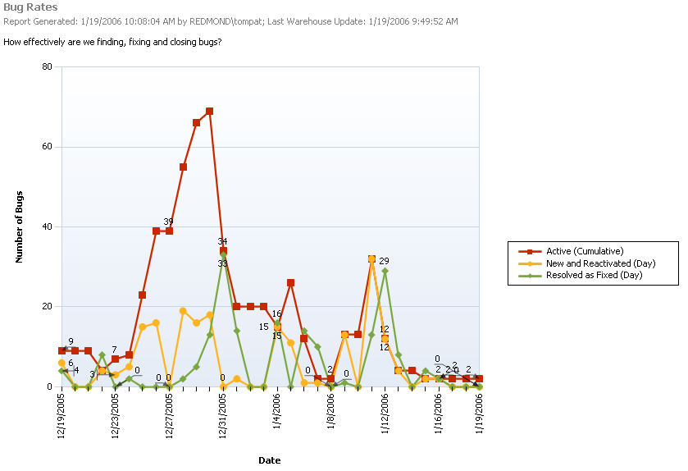
TFS Reporting - Bug Rates

Slide 24
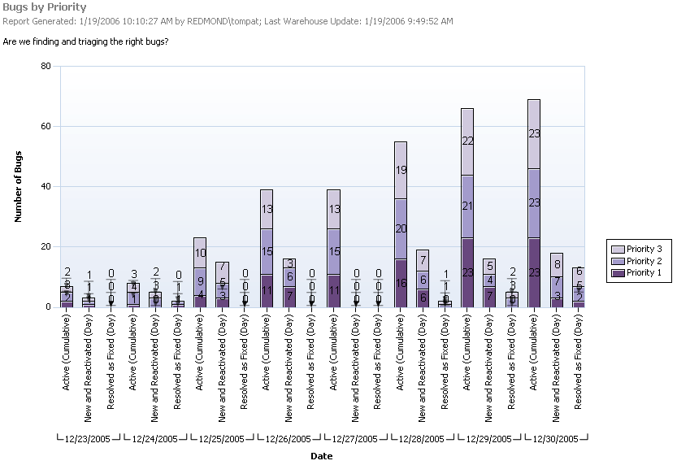
TFS Reporting - Bugs By Priority

Slide 25
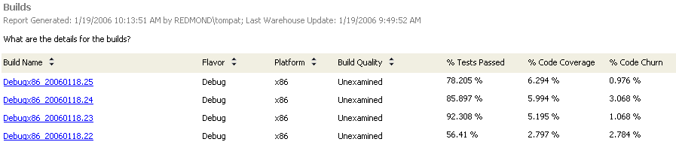
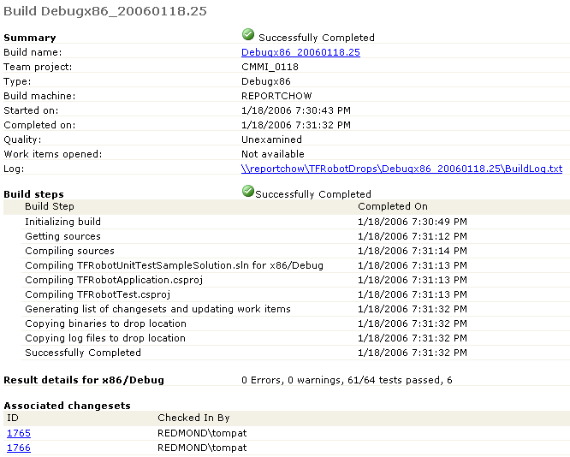
TFS Reporting - Builds

Slide 26
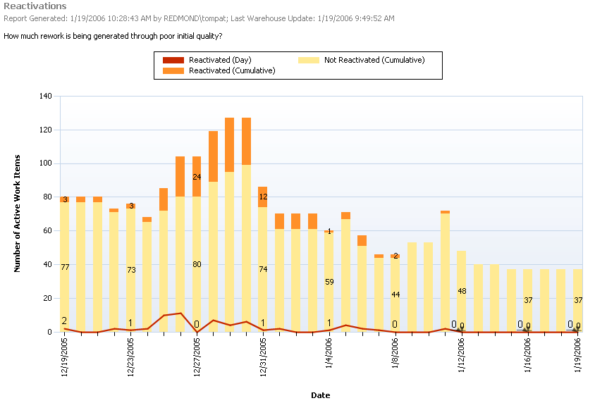
TFS Reporting - Reactivations

Slide 27
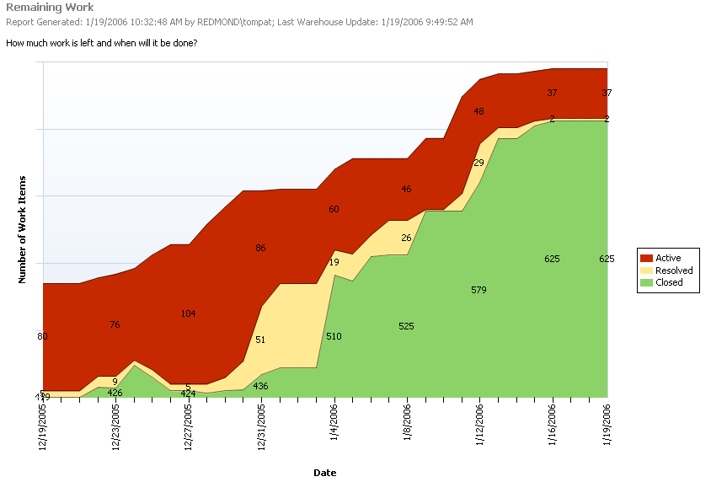
TFS Reporting - Remaining Work

Slide 28
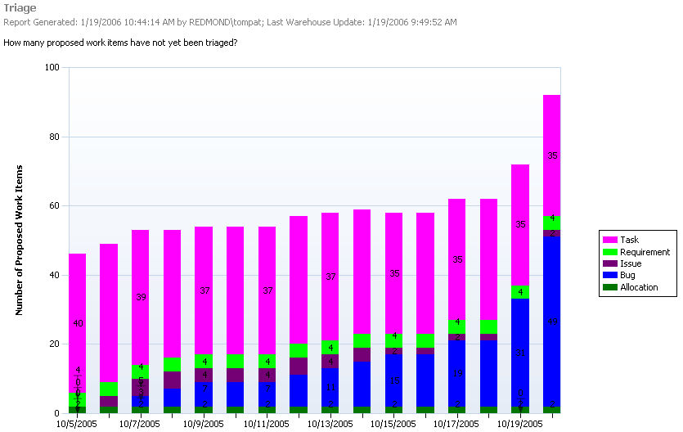
Triage

Slide 29
Demo: Version Control / Team Build
Lothar Wieske
Lifecycle Management Technology Specialist
Microsoft Deutschland GmbH

Slide 30
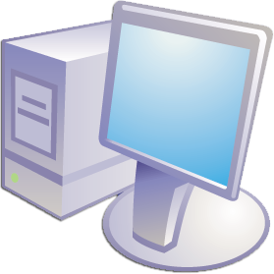








Visual
Studio
IDE
External tool
(Partner or MS)
Team Foundation Client API
Defect
Tracking
Web
Svc
SCC
Web
Svc
Partner
Tool 1
Web
Svc
Partner
Tool 2
Web
Svc
Team
Foundation Common
Services
Integration
Interface
Integration
Interface
Integration
Interface
Integration
Interface
Registration
Service
Notification
Service
Linking
Service
User
Groups
Service
Common
Structure
Service

Slide 31
TFS – Integration+Extension
Team Foundation Web Services
Partner Web Services
Work Item Service
Version Control Service
Team Build Service
Partner Service
Team Foundation Integration Services
Notification Service
Linking Service
Registration Service

Slide 32



Visual Studio Team System Dogfood
Users
Version control users: 605 (up 137)
Work items
Work items: 55,377 (up over 5,500)
Work item versions: 477,249 (up 60,000)
Attached files: 14,657 (up 1,800)
Version control
Files/Folders: 949,100/109,561 (up 330,000/37,000)
Total compressed file sizes: 73.9G (up 14G)
Workspaces: 1,281 (up 300)
Shelves: 397 (up 60)

Slide 33





The Team System Approach
Instrument the
Lifecycle
Single repository of all project data
Enable visibility and control
Process management
Enable Great
Teams
Rich collaboration platform
Workflow orchestration
Out of box productivity
Quality Early and
Often
Integrated lifecycle quality tools
Automation and enforcement
Making quality measurable

Slide 34
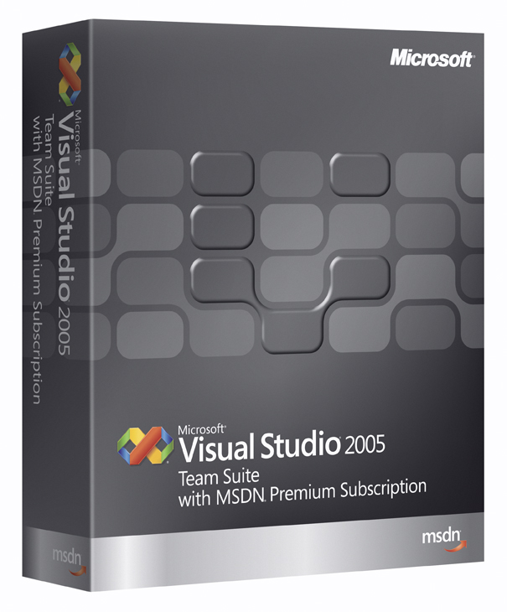
Jetzt handeln: Einführungsangebot Visual Studio 2005 Team Suite.
Für Neueinsteiger:
Bis zum 31. März 2006 Ersparnis von bis zu 40%
Für existierende Kunden (Team Edition Rolle, MSDN Universal/ Enterprise):
Nur noch bis zum 30. Juni 2006 günstiger Step-up auf die Team Suite möglich
Interesse an diesem Angebot oder einer Team Suite Test-Version (180 Tage)?
⇨ Kommen Sie an unseren Stand C0!
http://www.microsoft.com/msdn/transition

